Slide 1
2014 · SALES PERFORMANCE
2014 Sales
Performance Report
An executive readout of total sales, product mix, monthly movement, and management implications from the dashboard snapshot.
THE HEADLINE
₹18,307
Total sales for 2014.
Leadership readout · Total sales · Product mix · Monthly movement · Actions
Notes:
Open with the total: ₹18,307 in 2014. The report then shows where sales came from, when they moved, and what leadership should investigate next.

Slide 2
01 · TOTAL AND CONCENTRATION
Sales reached ₹18,307, with concentration in two products.
TOTAL SALES
₹18,307
for 2014
Primary driver
Primary driver
Beer
Fruit Cocktail
₹7,994
₹6,942
Long tail: Chocolate at ₹3,022 and Chocolate Biscuits Mix at ₹350.
Dashboard snapshot. Leadership implication: performance depends heavily on the two leading products, creating both a clear focus area and concentration risk.
Notes:
The total is concentrated: Beer and Fruit Cocktail are the clear primary drivers. Chocolate and Chocolate Biscuits Mix form the smaller long tail, so focus and concentration risk sit together.

Slide 3
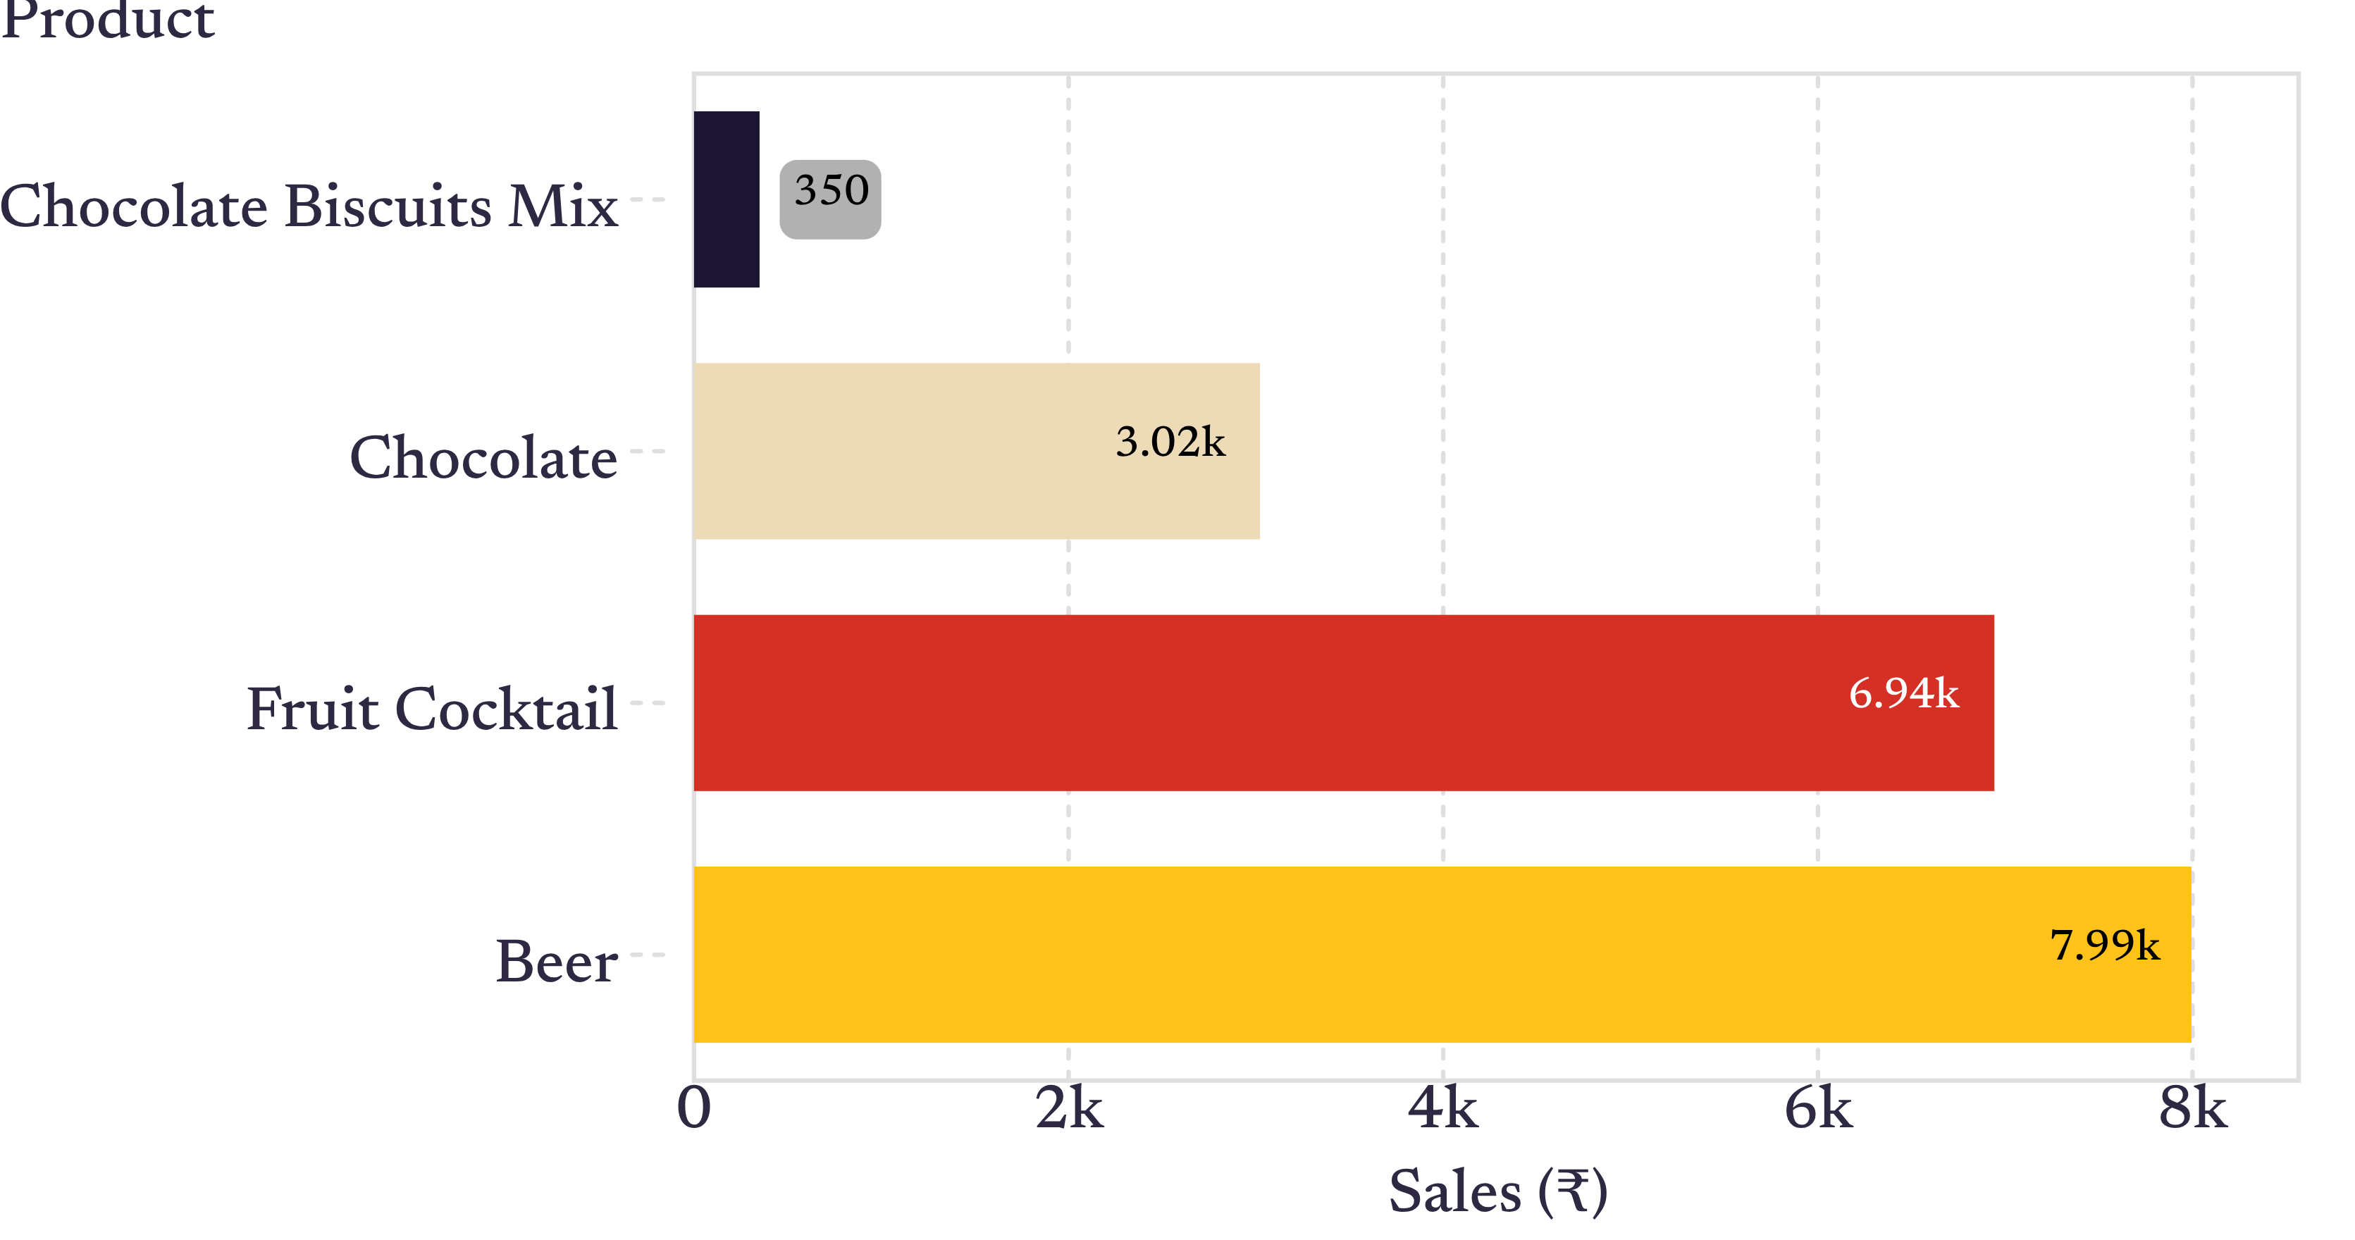
02 · PRODUCT MIX
Beer and Fruit Cocktail generated roughly four-fifths of visible product sales.
Beer and Fruit Cocktail dominate the visible product mix.
The visible product bars sum to ₹18,308 because of a one-rupee rounding or display difference versus the dashboard total of ₹18,307.
Sales by product · Dashboard snapshot
03
Notes:
Use the bars to make the concentration visible. Beer leads at ₹7,994, followed by Fruit Cocktail at ₹6,942. The one-rupee difference between visible bars and the dashboard total is a display or rounding note, not a new estimate.

Slide 4
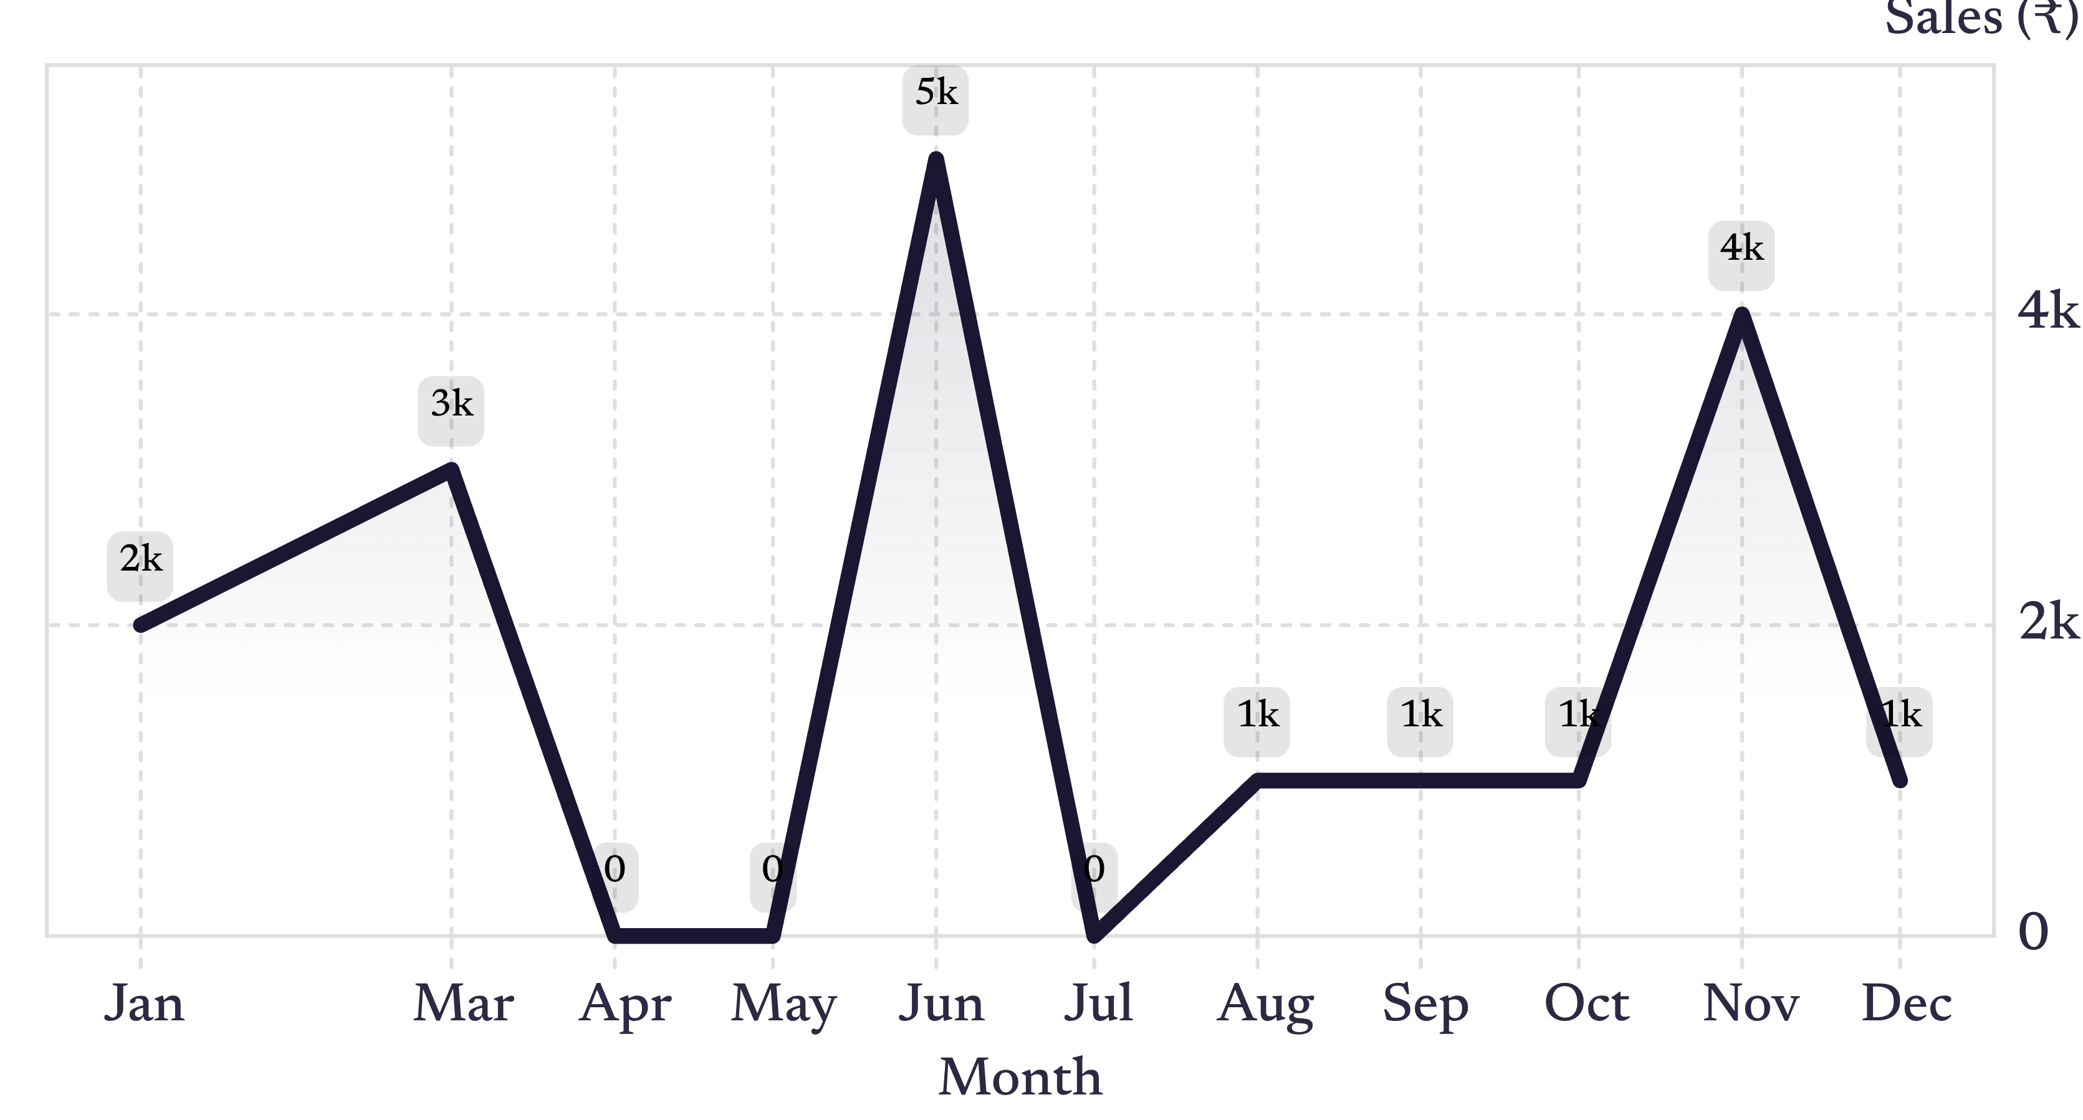
03 · MONTHLY MOVEMENT
June was the peak month, while the year remained uneven.
Peak
Recovery
Low points
June · ₹5,000
November · ₹4,000
Apr · May · Jul
April, May, and July are displayed as 0k; these may represent very small values rounded to 0k. February has no visible labeled point in the screenshot. Dashboard snapshot.
04
Notes:
June is the clear peak at ₹5,000, followed by a sharp fall in July. November shows a second rise to ₹4,000, while the near-zero months need validation before they are treated as true demand signals.

Slide 5
04 · MANAGEMENT IMPLICATIONS
Prioritize the winners, then investigate the volatility.
01
Protect Beer and Fruit Cocktail
Prioritize availability and promotion for the two largest visible contributors.
02
Explain the spikes
Review the causes of the June and November spikes, then test whether the same drivers can be repeated.
03
Validate the near-zero months
Confirm whether they reflect true demand, missing records, or chart rounding.
04
Focus the long tail
Set a focused growth plan for Chocolate and Chocolate Biscuits Mix rather than spreading effort evenly across the range.
This report is based on one dashboard snapshot; trend explanations and salesperson-level conclusions require the underlying data.
Notes:
Close with the sequence: protect the winners, understand the spikes, validate the low months, and give the smaller products a focused growth plan. Keep the limitation visible: one dashboard snapshot cannot support trend explanations or salesperson-level conclusions.

